Slide 1
Towards a Localized Identity assignment Algorithm
Currently our model assumes:
Every agent is geographically connected to every other.
Every agent looks at the opinions of all other agents to determine identities.
Issues:
Expensive & hard to scale – identity assignment step is O(nlogn) with louvain
Unrealistic for larger networks – people are limited in their access to the opinion space.

Slide 2
Part I – The Network

Slide 3
What we have now
Fully geographically connected network ~100 agents
Opinion-based dynamics with HK rule in 1D
Identity-based dynamics with Louvain+clustering
Connectivity limited by only opinion and identity differences

Slide 4
What kind of network do we want?
Moving away from full connectivity –
Network can represent (spatial/geographic + digital accessibility)
How do we define this network?
Realistic parameters?
What do large-scale ABM’s of opinion dymamics do?

Slide 5
Part II – Opinions and Social influence
Some questions:
Do we need a multidimensional opinion model for RSM?
Do we stick with HK, or do we go with a more local model for opinion sharing such as DW?
DW: Pairwise communications. Can be made to be about a specific topic/opinion dimension.

Slide 6
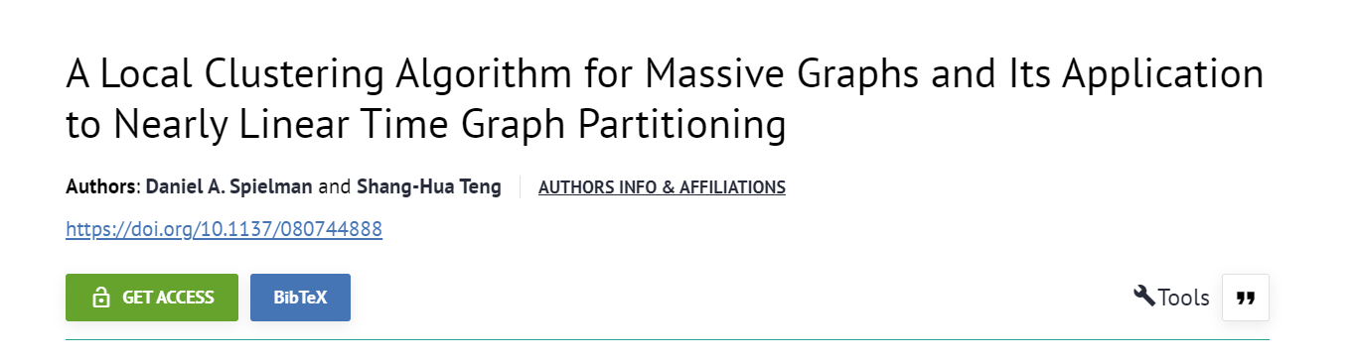
Part III – Social identity
Possibility: Computational equivalency.
Problem:
Currently in our algorithm, every cluster found counts as a distinct identity group.
In a localized clustering scenario, we will have tons of clusters potentially.
How can two agents in completely different spatial/geographical locations identify with the same identity group? More generally how are all agents aware of the same set of possible identity groups?
Some mechanism to propagate ‘knowledge’ of existing identity groups, along with opinions?

Slide 8
Some notes
Two kinds of acquaintances: you know personally and online.
How does SI emerge?
How does it propgate – Socialization?
Some people take the identities of their accessible people – friends, family etc.

Slide 9
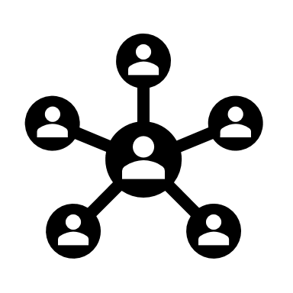
Larger network ~mil agents
Geographic constraints.
Geographic edges aren’t just proximity
Accessibility - via media or SM

